Slide 1
An Android POS Application for Restaurant Management and Food/Beverage Suggestions using ECLAT Algorithm
Presented by
Murali Krishna Reddy Survi
Committee
Dr. Zhengxin Chen
Dr. Sanjukta Bhowmick
Dr. Sajda Qureshi

Slide 2
Agenda
Introduction
Objective
Theoretical Concepts
Implementation
Results
Challenges
Conclusion
Future Work
References

Slide 3
Introduction
Restaurant Management System
What is a POS Android application ?
Eg: Touch Bistro
Benefits of POS Application
Integration of ECLAT algorithm with POS Application

Slide 4
Objective
My project underscores the need for the infusion of the concepts of data mining into restaurants
Develop an Android POS application for Restaurants equipped with ECLAT algorithm
Application should streamline the activities in restaurant
Store transactions in database and generate frequent patterns to customers based on this data
Notes:
Yelp

Slide 5
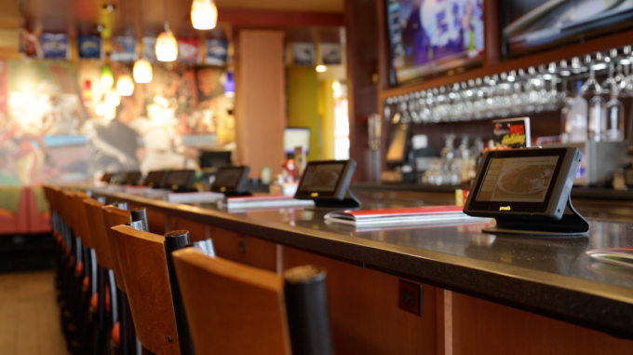
How it looks like?

Slide 6
Theoretical Concepts
Association rule mining
Apriori Algorithm
ECLAT Algorithm
Apriori vs. ECLAT

Slide 7
Data Mining
Discovering unknown interesting patterns
Analyzing structured/unstructured data
Tasks
Association Rule Mining
Clustering
Classification

Slide 8
Association Rule Mining
Association rule mining
Finding frequent patterns, associations, correlations, or causal structures among sets of items or objects in transaction databases, relational databases, and other information repositories.
Itemset
A collection of one or more items
Example: {Milk, Bread}
k-itemset
An itemset that contains k items

Slide 9
Association Rule
Association Rule
An implication expression of the form X → Y, where X and Y are itemsets
Example: {Milk, Diaper} → {Beer}
Rule Evaluation Metrics
Support (s)
Fraction of transactions that contain both X and Y
Confidence (c)
Measures how often items in Y appear in transactions that contain X
Example:

Slide 10
Mining Association Rules
Two-step approach
Frequent Itemset Generation
Generate all itemsets whose support > minsup
Rule Generation
Generate high confidence rules from each frequent itemset, where each rule is a binary partitioning of a frequent itemset
Frequent itemset generation is still computationally expensive

Slide 11
Candidate Itemset Generation
Given d items, there are 2^{d} possible candidate itemsets

Slide 12
The Apriori Algorithm
Given a set of transactions T, the goal of association rule mining is to find all rules having
support ≥ minsup threshold
confidence ≥ minconf threshold
Frequent Itemset Property:
Any subset of a frequent itemset is frequent.
Contrapositive:
If an itemset is not frequent, none of its supersets are frequent.

Slide 13
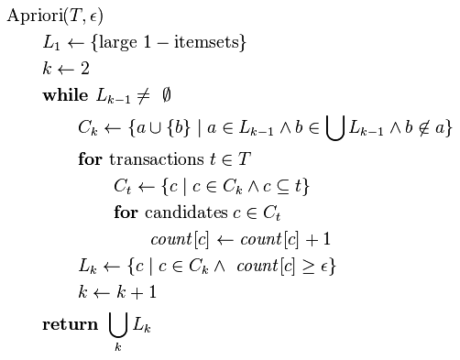
Pseudo code

Slide 14
Example
Min support =50%
Database D
L₁
C₁
Scan D
C₂
C₂
L₂
Scan D
C₃
Scan D
L₃

Slide 15
Bottlenecks of Apriori
Huge candidate sets:
10⁴ frequent 1-itemset will generate 10⁷ candidate 2-itemsets
To discover a frequent pattern of size 100, e.g., {a₁, a₂, …, a₁₀₀}, one needs to generate 2¹⁰⁰ ≈ 10³⁰ candidates.
Multiple scans of database:
Needs n scans, n is the length of the longest pattern
The worst-case computational complexity is O(|I| · |D| · 2^{|I|}), since all itemsets may be frequent.

Slide 16
ECLAT Algorithm

Slide 17
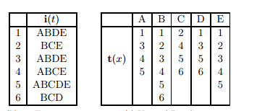
Tidset
Tidset
A set of Transaction identifiers T = {t₁, t₂… t_{n}} are called tids and subset of T i.e. T ⊂ T is called a tidset.
Example:

Slide 18
Principles
ECLAT algorithm uses two basic principles
If an itemset X is frequent, then any subset Y ⊇ X is also frequent and if X is not frequent, then any superset Y ⊇ X cannot be frequent
The support of a candidate itemset can be computed by intersecting the tidsets of suitably chosen subsets

Slide 19
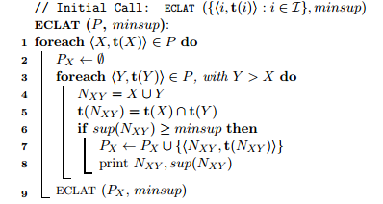
ECLAT Algorithm

Slide 20
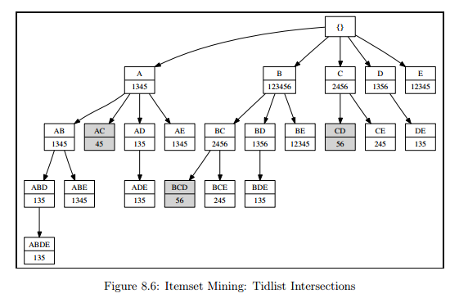
Tidset Intersection Approach

Slide 21
Advantages
If Itemset-Tidset fits in memory, only one scan is sufficient
Unnecessary candidate generation is not required
If t is the average transaction size, and if ‘l’ is the longest frequent itemset, the computational complexity is close to O(t * 2^{l}) less than Apriori

Slide 22
Implementation

Slide 23
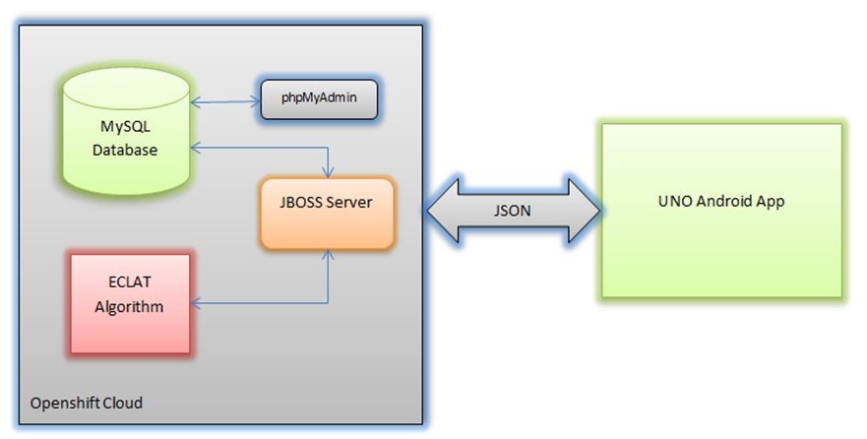
Block Diagram

Slide 24
Development Environment
Eclipse ADT with Android SDK
Openshift JBOSS server
MySQL database
phpMyAdmin
Java J2EE (Webservices & ECLAT Algorithm)
JSON

Slide 25
User roles
Admin
Manages data and application
Manager
Login
Add/delete/update menu
View pending orders
Serve pending orders
Customer
Create profile/login
View latest menu
Place order
View suggestions

Slide 26
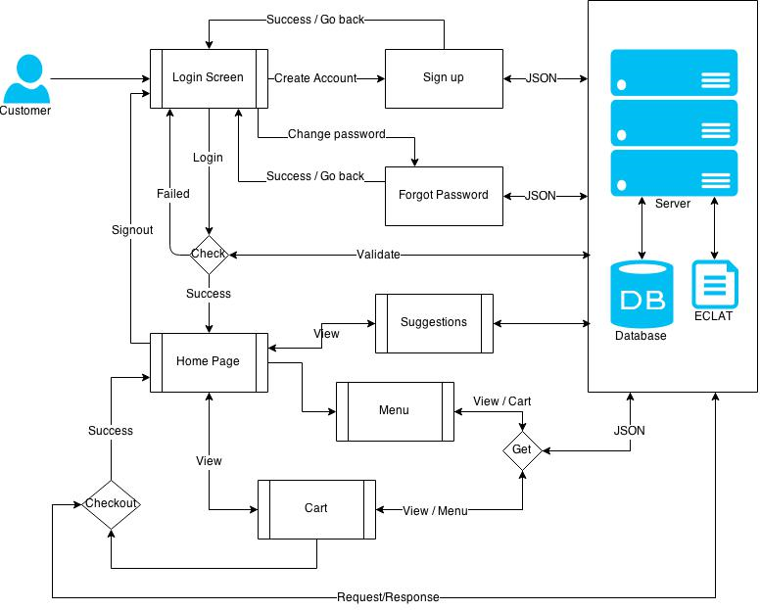
Process Flow - Customer
Next slide

Slide 27
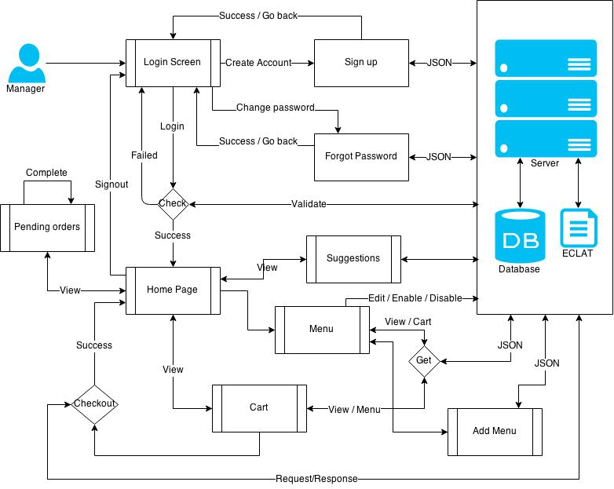
Process Flow - Manager

Slide 28
Database Schema

Slide 29
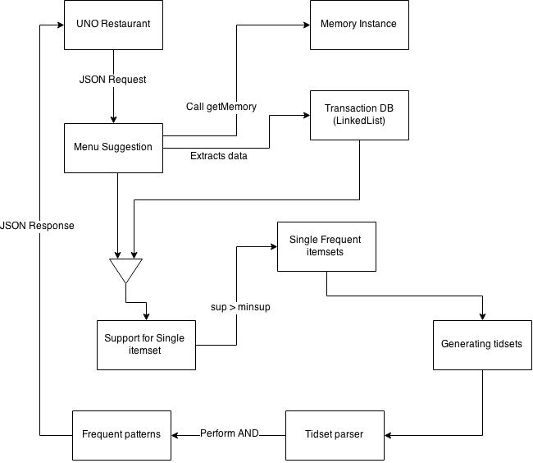
Generating frequent patterns

Slide 30
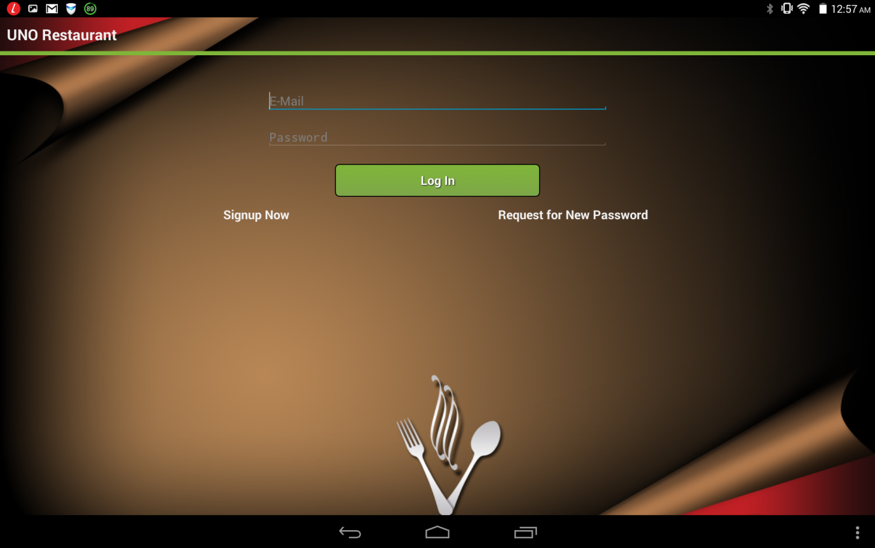
Login

Slide 31
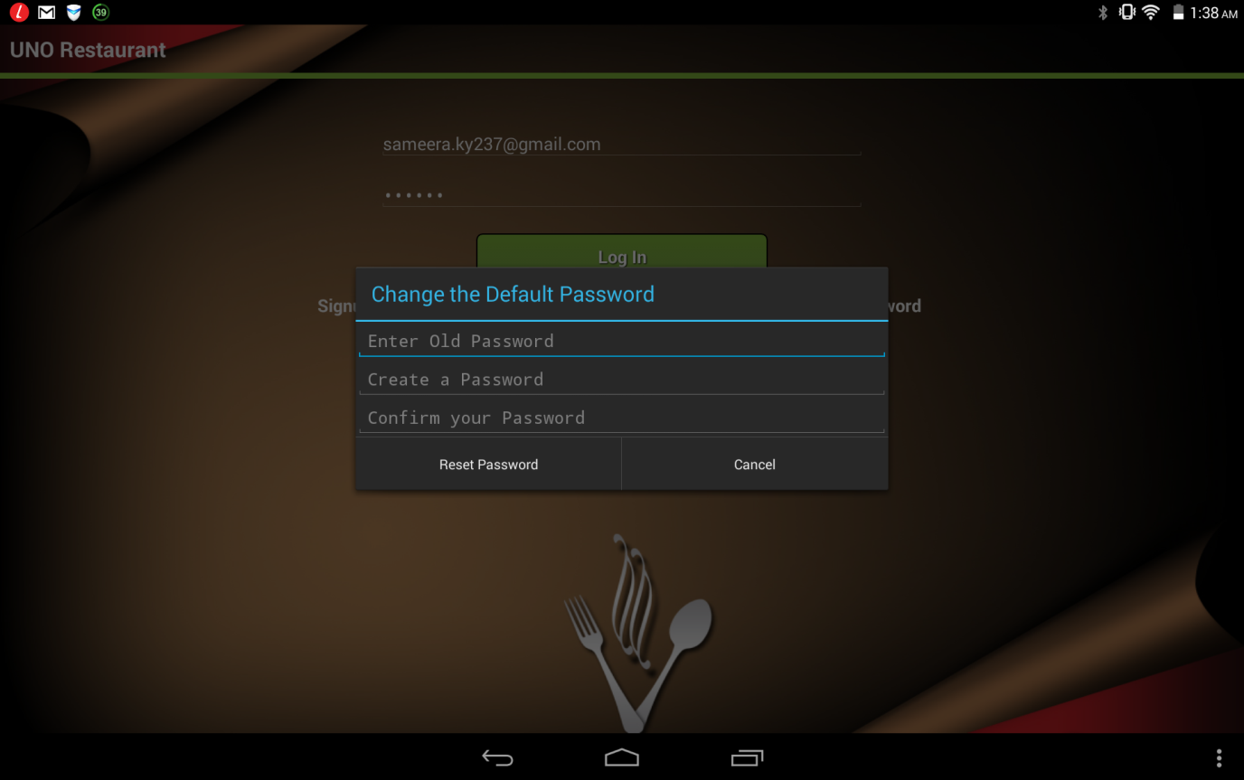
Reset password

Slide 32
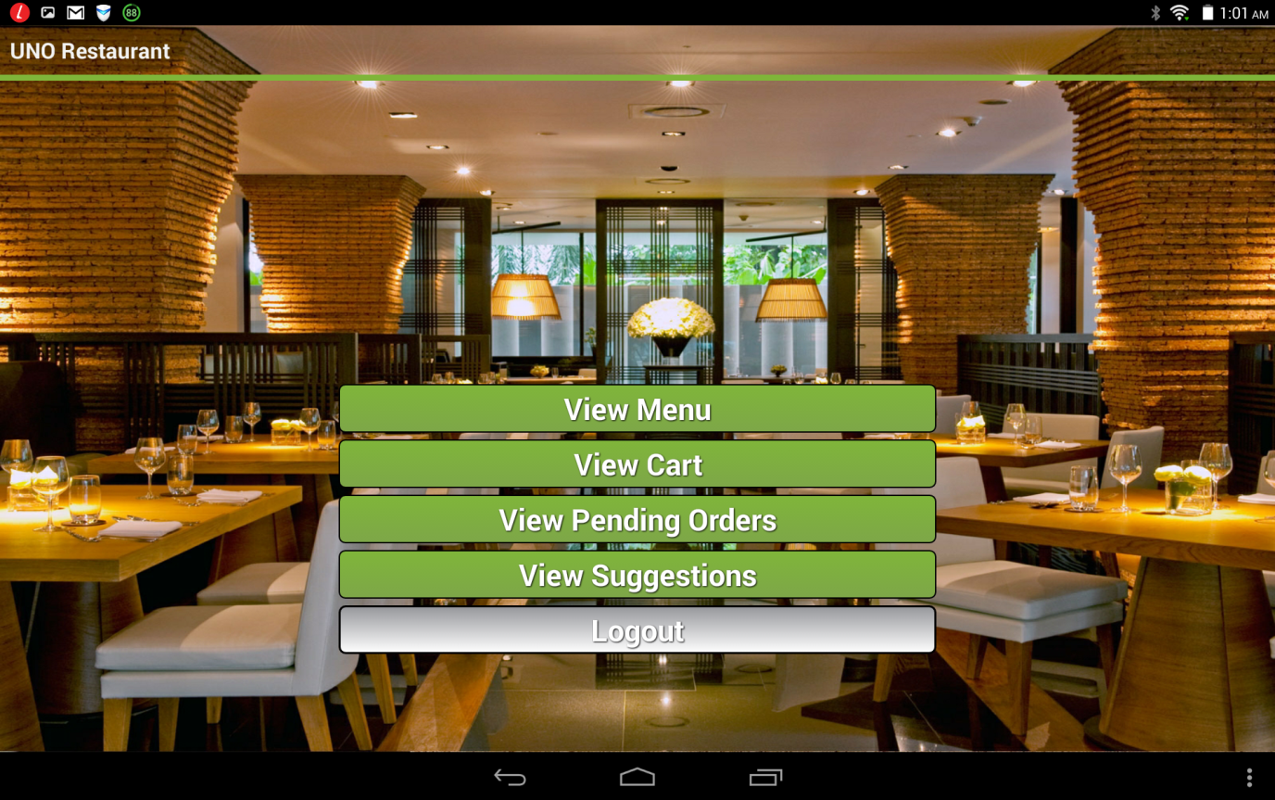
Home page
Manager

Slide 33
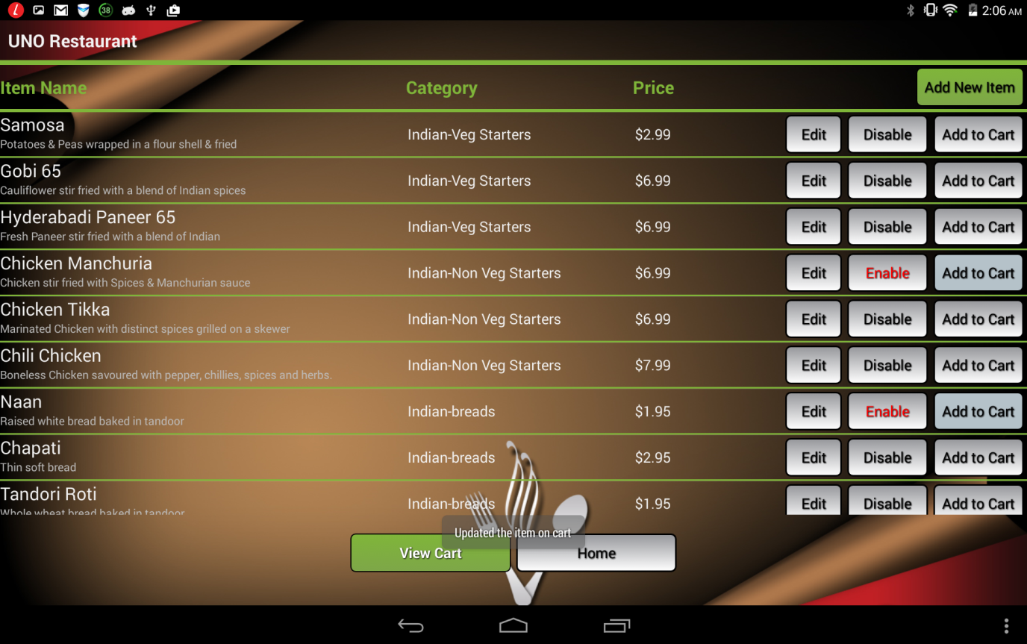
Menu
Manager

Slide 34
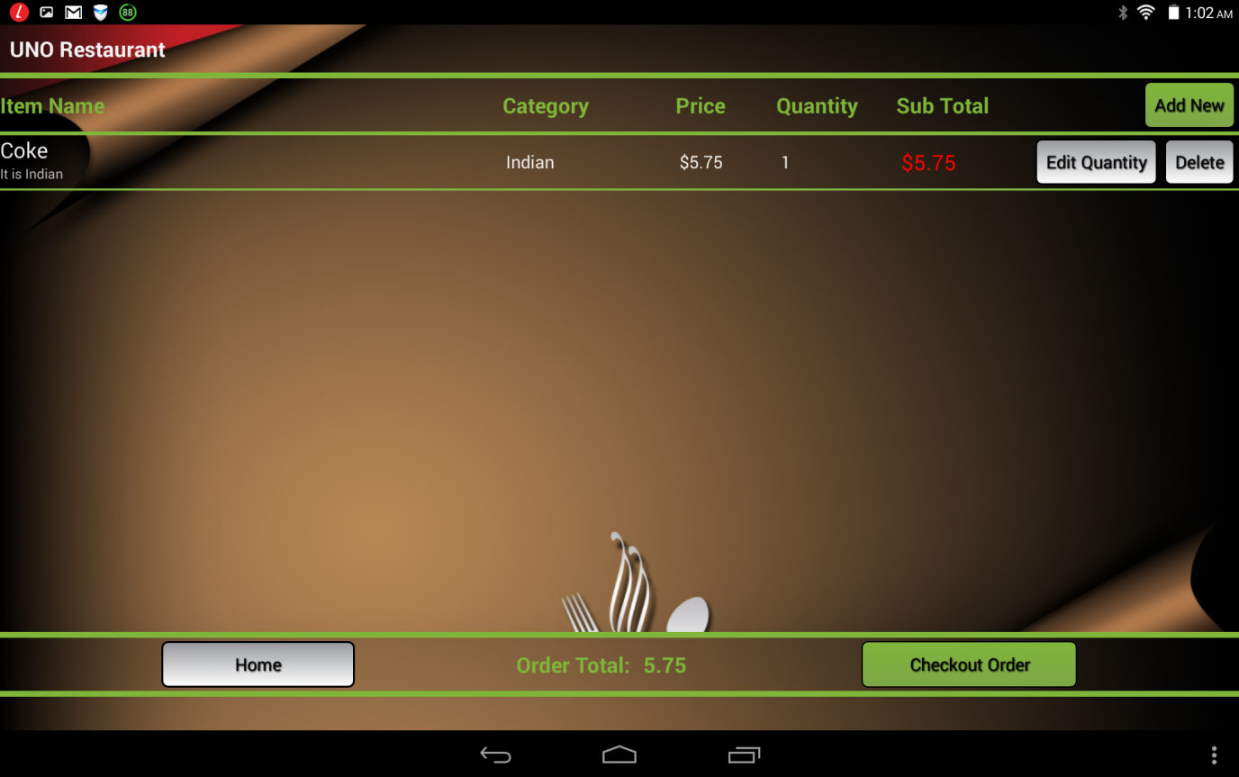
Cart

Slide 35
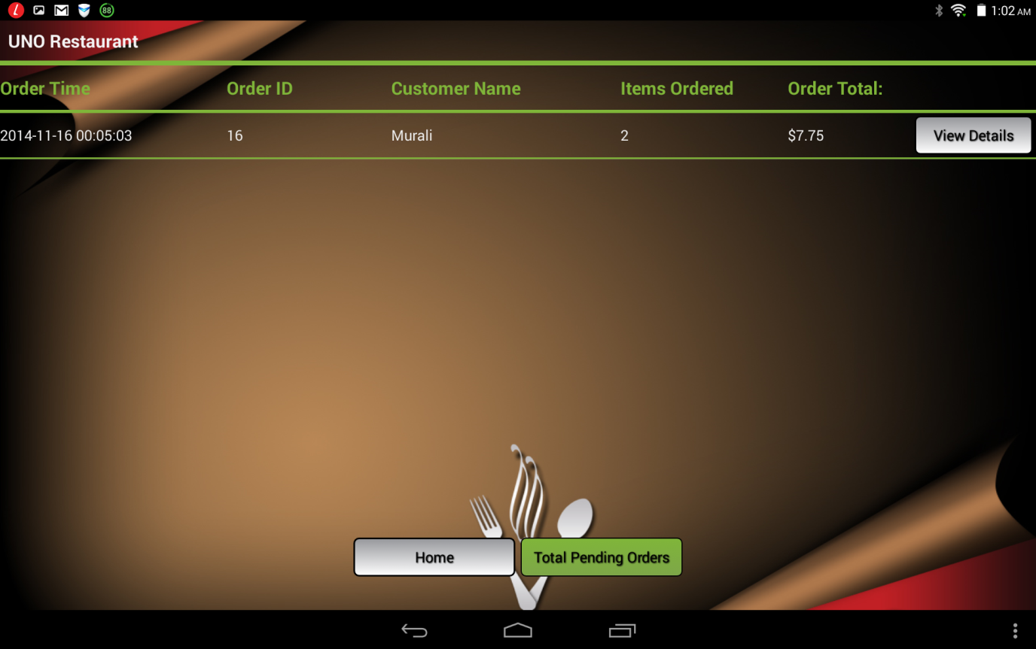
Pending orders

Slide 36
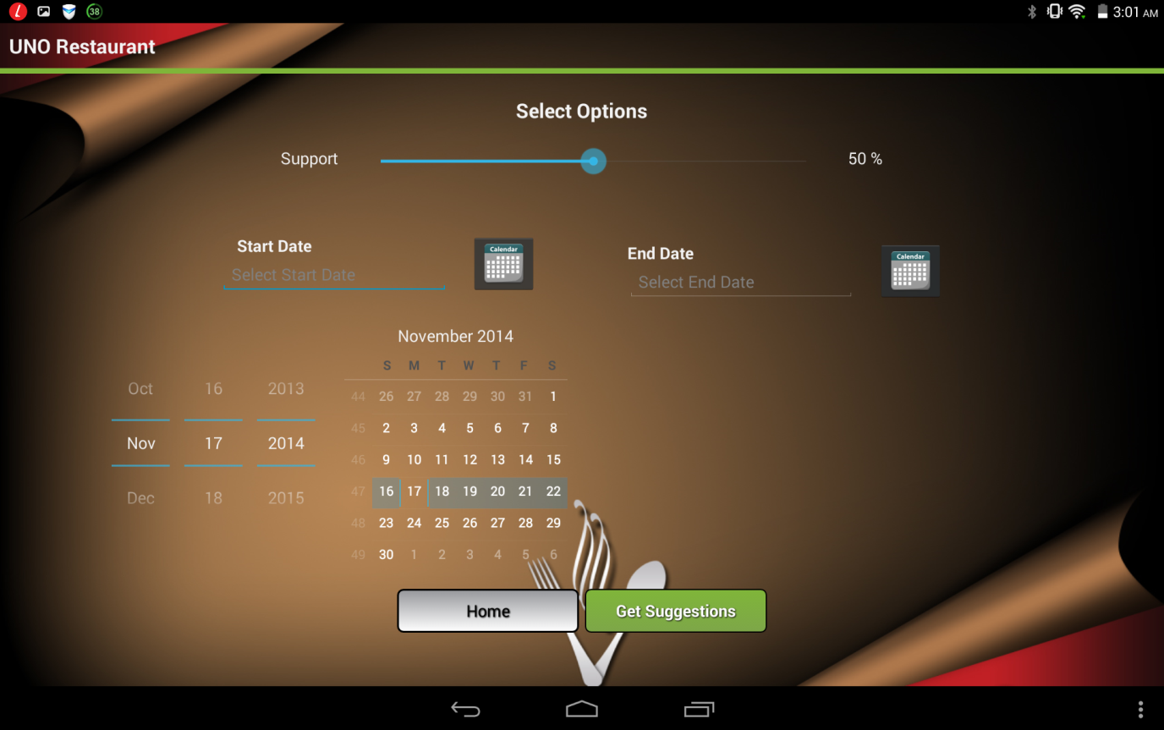
Filters

Slide 37
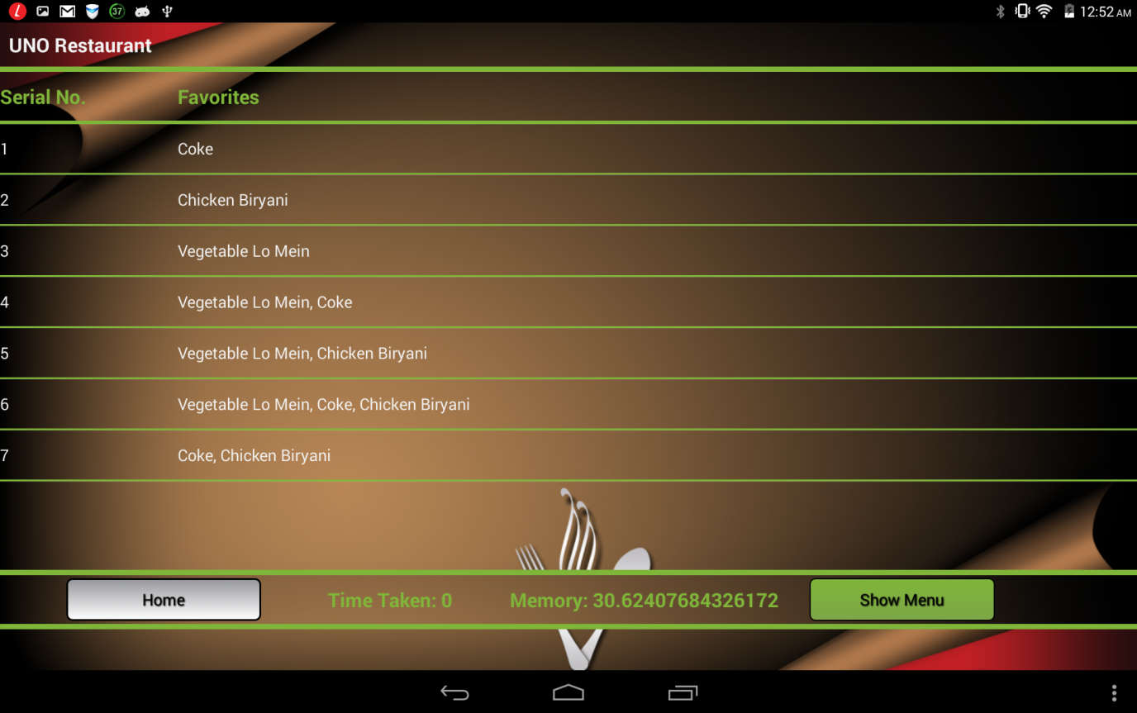
Suggestions

Slide 38
Results

Slide 39
Challenges
Data collection
Integrating ECLAT with android application
Extracting input to ECLAT algorithm from transactions
Handling large data with HTTP request/response

Slide 40
Conclusion
A new way of injecting data mining into restaurants business has been implemented
Implemented a solution for real-world scenario which reduces manual dependence and intervention to a bare minimum
This approach would increase profits for a business and also benefits customers with interesting suggestions

Slide 41
Future work
Compare results from ECLAT algorithm with other association rule mining algorithms
Improve application to accommodate internet outage and include payment facility
Applications can be extended to other mobile platforms
Customers can be provided with a status of order they placed

Slide 42
References
Zaki, M. J. (2000). Scalable algorithms for association mining. Knowledge and Data Engineering, IEEE Transactions on, 12(3), 372-390.
Saxena, A., & Gadhiya, S (2014). A Survey on Frequent Pattern Mining Methods Apriori, Eclat, FP growth. C.U. Shah College of Engineering and Technology.
https://www.cs.purdue.edu/homes/aref/cs-690d-presentations/MiningAssociationRules.ppt
http://www.cs.sjsu.edu/faculty/lee/cs157b/Gaurang%20NegandhiApriori%20Algorithm%20Presentation.ppt

